Slide 1
ECHO ASSESSMENT OF VSD
DR.VIGNESH
SENIOR RESIDENT
DEPARTMENT OF CARDIOLOGY
Notes:
2nd MC CHD

Slide 2
The History
1879 – Henri Roger auscultatory finding of VSD
Lillehei-first successful surgical closure
1987 – first successful device closure Lock et al with Rashkind double umbrella
Notes:
French paediatrician @70yrs

Slide 3
INTER VENTRICULAR SEPTUM
3-D, complex, helical / curved structure.
Membranous septum(~ 5%)
Muscular septum( ~95% )
Inlet
Trabecular
Outlet / Infundibular

Slide 4
Notes:
Inlet- smooth,from septal attachment of TV to distal attachment of Tricuspid Tensor apparatus

Slide 5
HOW ?
WHAT ?
WHERE ?
WHICH?
WHEN ?
WHY ?

Slide 6
How is it formed ?
What lies where ?
How to look ?
What to look ?
What to do ?
When to do ?

Slide 7
Notes:
conus & prox 1/3 of bulbus cordis merged with prim ventricle
Ventricular cavity- seperate communicaion with respective atrium

Slide 8
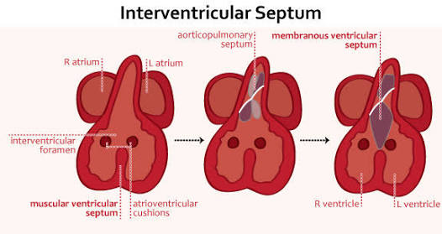

Slide 9
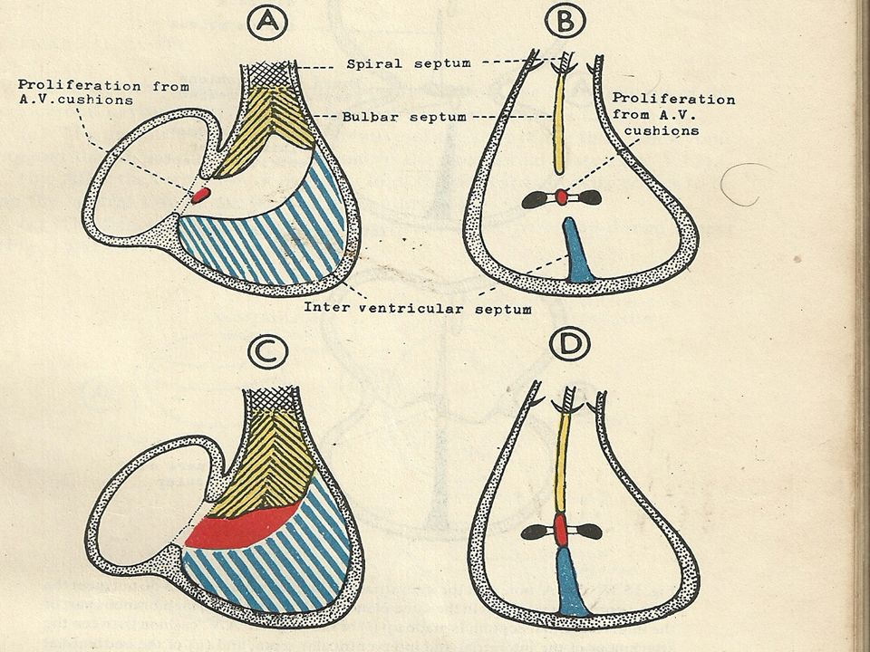
Notes:
Muscular- IVS grows upward from the floor- divides into right and left halves
meets the fused AV cushions (septum intermedium) and partially fuses- cephalic end- dorsal & ventral horn
BULBAR- right(d) & left(v) ridges

Slide 10
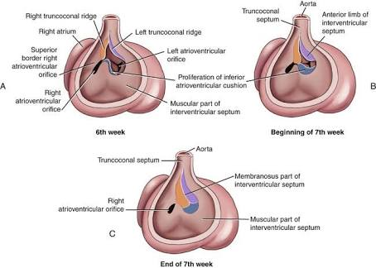
Notes:
Memb septum- rt & lt bulbar ridges & rt av cushion

Slide 11
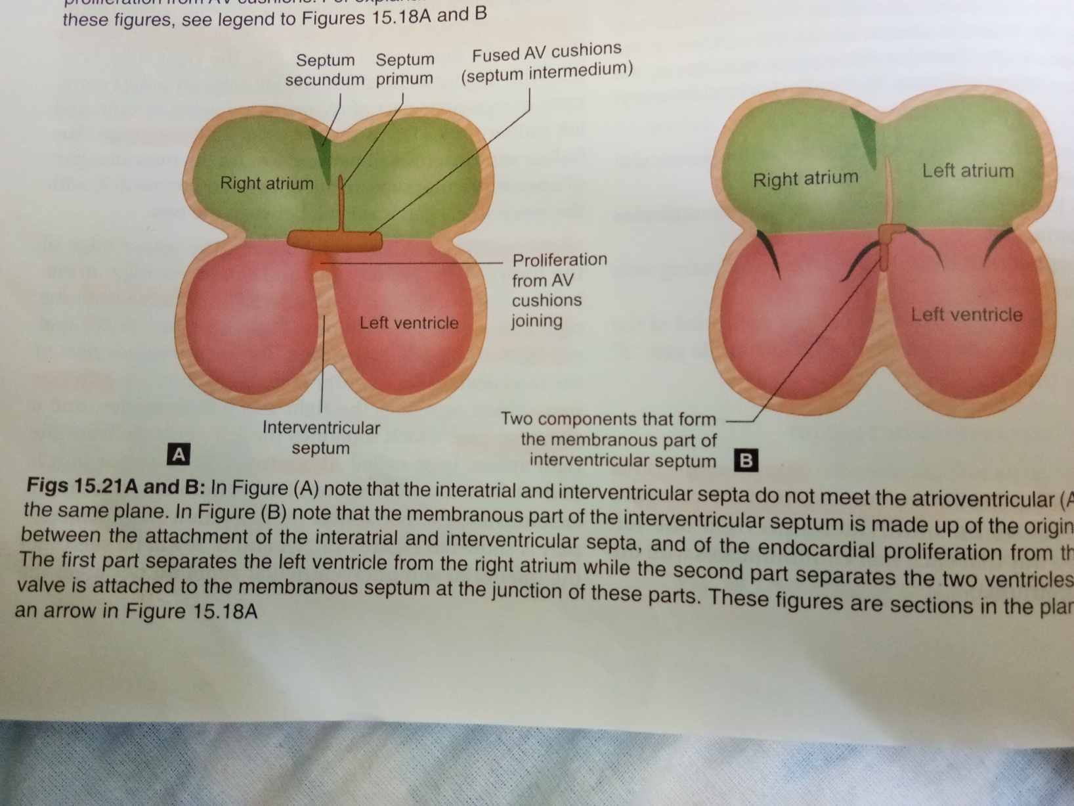
Notes:
Inter ventricular & atrioventricular components
Ant part – lv from rv Post part - lv from ra

Slide 12
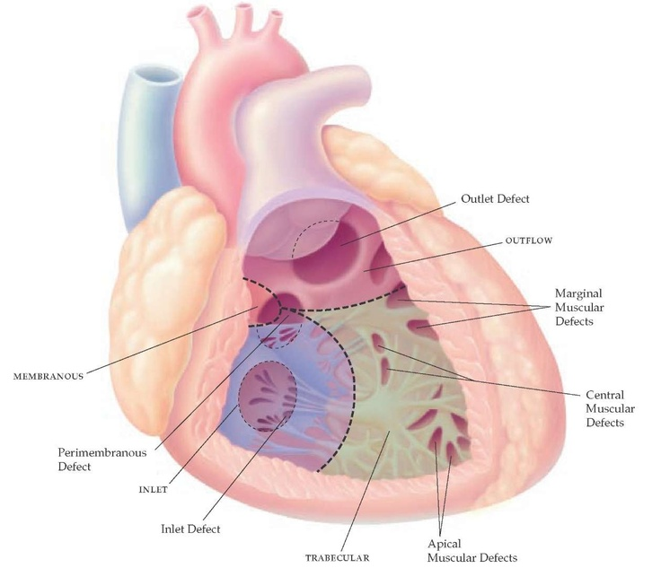

Slide 13
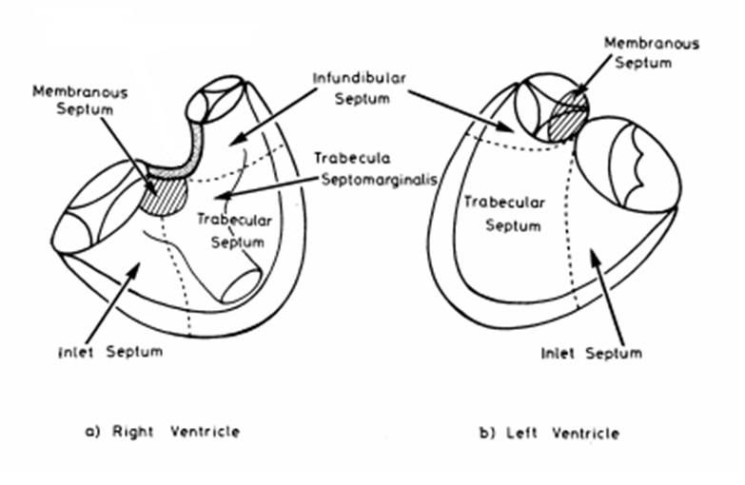

Slide 14
TYPES OF VSD
Notes:
Chance of spontaneous closure - Surgical approach - Risk of conduction system involvement - Likelihood of valvular dysfn(AR)

Slide 15
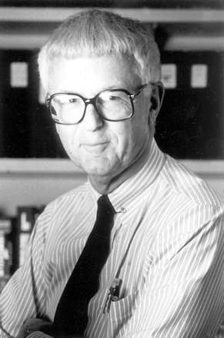
Kirklin et al 1960
TYPE 1: Subarterial defect, superior-anterior part of IVS ~ 5% [Supracristal / Infundibular]
TYPE 2: Middle of the upper portion of IVS in the memb portion of IVS- PM ~75%
TYPE 3: Posterior portion of IVS in close proximity to the tricuspid valve giving it an inlet extension [AV Canal defects] ~5%
TYPE 4: Muscular part mostly apical single/multiple ~10-15%

Slide 16
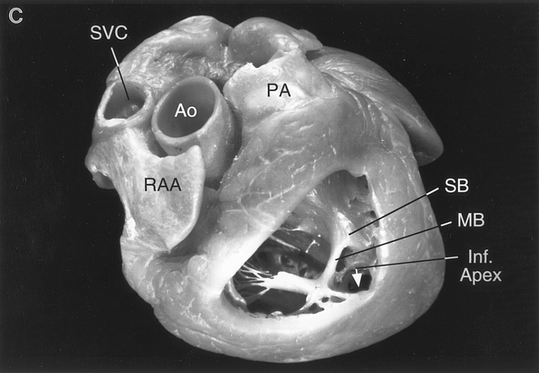
Muscular VSD
Anterior:
Anterior to the septal band
Midmuscular:
Posterior to the septal band
Apical:
Inferior to the moderator band
Posterior:
Beneath the septal leaflet of tricuspid valve

Slide 17
Perimembranous (membranous/infracristal )- 70-80%
Muscular/trabecular- 5-20%
Anterior
Mid muscular
Apical
Marginal- along RV septal junction
Swiss cheese septum – multiple defects
Inlet/ AV canal type- 5-8%
Outlet/Supracristal- 5-7%

Slide 18
Anderson et al
Relation of defect to atrioventricular axis
Perimembranous
Muscular
Doubly committed juxta arterial
Juxtatricuspid(non-perimembranous)

Slide 20
Society for Thoracic Surgery and the European Association for Cardiothoracic Surgery classification (2000)
TYPE 1: Infundibular defects
(supracristal, subarterial, subpulmonary, conal, or doubly committed juxta-arterial VSD)
TYPE 2: Membranous defects– Conoventricular
TYPE 3: Inlet defects - AV canal type
TYPE 4: Muscular defects

Slide 21
2-D Echo/Color Doppler Assessment of VSD

Slide 22
Ventricular septum is curved hence require multiple views.
Sensitivity highly depends on location of defect.
False -ve are MC than False +ve
Location of defect | Sensitivity
Inlet & Outlet | ~100 %
Perimembranous | 80-90 %
Trabecular | As low as 50 %
Large Area
Small & Multiple
Complex shape (narrow & irregular)
Orifice obscured in systole

Slide 23
2-D ECHO location of various VSD

Slide 24
? Membranous VSD ?? Perimembranous VSD ??? Paramembranous VSD

Slide 25
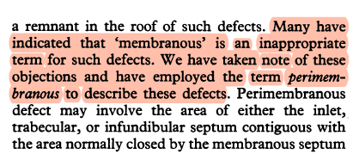
Perimembranous VSD
Paramembranous VSD
Van Praagh et al
Perimembranous- misnomer
“Peri” greek → around
Appropriate term→ Paramembranous as defect lies besides the membranous septum

Slide 26
Perimembranous Defect
Mc variety
~80%(feigenbaum)
Extension into adjacent septum
Not seen in A4C
PSAX >>PLAX (Medial Angulation)

Slide 27
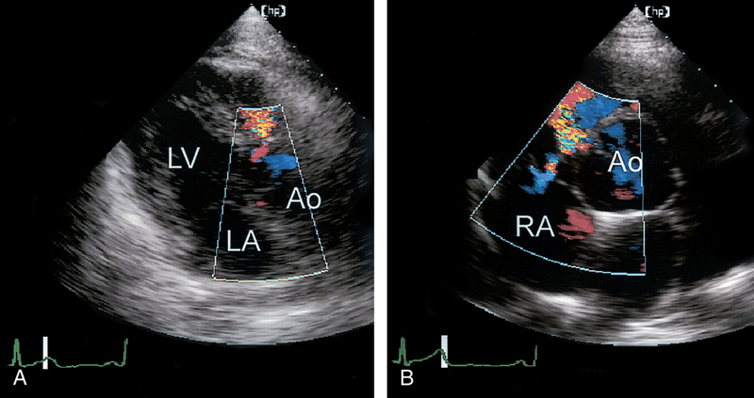
Perimembranous VSD
A.PLAX B.PSAX

Slide 28
Notes:
PSAX- scan plane just below the annulus- both membranous and outlet septum can be visualised

Slide 29
Trabecular Defects
Difficult with 2d echo alone
All planes sequentially examined- basal to apical
Narrow irregular channels
One defect identified→ possiblity of multiple defects to be r/o.. [Apical defects] – Swiss Cheese Septum
Colour Doppler across septum- look for Lt→Rt jets
Location unknown→ Left Parasternal, Apical, Subcostal

Slide 30
Trabecular VSD
Notes:
A4c- obvious defect in IVS
Turbulent jet

Slide 31
Inlet defects
Infrequntly in isolation
Usual component of ECD
a/w Down`s Syndrome
A4C- ideal view to look for inlet vsd`s
Most inlet defects are large
Look for normal apical displacement of TV
If both valves are in same plane → AVCD
If Septal Malalignment +→ R/o stradlling/ overriding
Notes:
Probe tilt ant- outlet portion seen
Tilt inferiorly- inlet portion seen

Slide 32
Inlet VSD
Note the defect & relationship between AV valves
SAX –Proximity to TV

Slide 34
Inlet VSD + OP-ASD→ AVCD

Slide 35
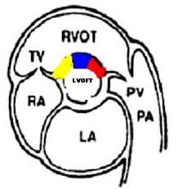
Outlet defects
Sub arterial defects
PSAX –classifies into
SUPRA CRISTAL – far left & adjacent to pulm valve
Often small and may be missed- use colour doppler
R/o Aortic Regurg ( usually a/w enlargement of SOV)
INFRACRISTAL – almost @ midline & away from pulm valve
R/o Aortic Regurgitation esp in supracristal defects
more common in Asians

Slide 36
Outlet VSD
Restrictive
Infracristal
Notes:
PLAX-similar to PMvsd
PSAX- near pulm valve
High velocity jet- small & restrictive

Slide 38
Outlet VSD Supra cristal Restrictive
PLAX - Medial angulation
PSAX- confirms supracristal location

Slide 39
Notes:
PSAX- scan plane just below the annulus- both membranous and outlet septum can be visualised

Slide 40
Aortic Regurgitation
Common with outlet defects
Also seen with PM-VSD
Absent Myocardium below the annulus, Unsupported cusp & Venturi effect
Surgical closure recommended even in absence of large shunt to reduce risk of progressive AV dysfn
VSD | Outlet | Perimembranous
Prolapse of Aortic Cusp | 73% | 14%
Progression to significant AR | 52-78% | 6%

Slide 41
Ventricular Septal Aneurysms
Usually a/w PM-VSD
Membrane of tissue from margin of defect
Septal leaflet of TV incorporated
PLAX & PSAX –seen as thin memb pouches – bulge through defect→ Windsock Appearance

Slide 42
Ventricular Septal aneurysm Residual Shunting +

Slide 43
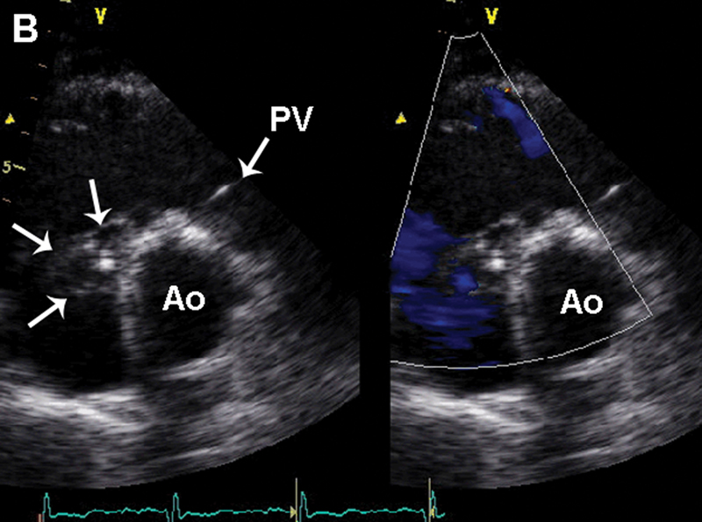

Slide 44
Gerbode Defect
.08% of all CHD
1/3rd a/w ASD
Acquired Gerbode-
IE
Trauma
MI
Post Surgical closure of vsd
Post Valve Replacement
Reimenschneider & Moss
Supra Valvular
Infra Valvular
Notes:
Biventricular Failure unusually dilated RA

Slide 45
Classification of Gerbode
TYPE 1:
Supravalvular – 1/3rd Shunt above the SL of TV
Direct Type, LC form, usually acquired d/t IE
TYPE 2:
Infravalvular, MC form, Remaining 2/3rd
LV→RV→(through defect in TV)→RA
Septal Leaflet Perforation
Indirect type
TYPE 3:
Combined supravalvular & Infrvalvular

Slide 46
Between LV → RA
Direct / Indirect
Defect seen below the AV but above TV

Slide 47
Gerbode Defect

Slide 48
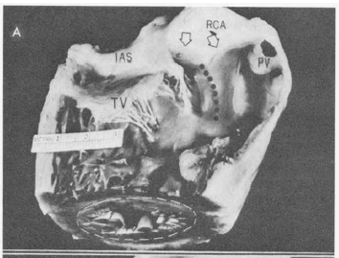
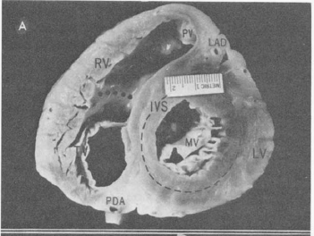
cs

Slide 51
Doppler Imaging
Helps in
Diagnosis
Assess flow direction & timing
Velocity of flow
Smaller defect → turbulent high velocity thin jet
Larger defect → wider low velocity jet.

Slide 52
PG across VSD
A & B. High jet velocities suggesting → normal RVSP
C. Low Jet velocity (PG ≈25 mmHg) → high RVSP

Slide 53
Large outlet VSD resulting in Eisenmenger
B. High velocity TR jet confirm elevated RVSP
C. PW Doppler consistent with PH

Slide 54
Doppler Measurements
IVG (mmHg) = 4v² {modified Bernoulli equation}
PG (mmHg) = LVSP – RVSP
LVSP - PG jet = RVSP ≈ PASP (mmHg)
RVSP (mmHg) = cuff systolic BP – 4v²
[ if TR present, RVSP (mmHg) =RAP+4V²_{TR} ]

Slide 55
Shunt Quantification
Two methods
1. Shunt (Qp/Qs): CO_{PV}/CO_{AV}
2. Qp = Qs + VSD shunt
(Second method had better correlation with shunt ratios determined by the Fick method than the standard pulsed Doppler calculation of Qp /Qs)

Slide 56
TEE in VSD
Preoperative TEE exam confirm
Defect location, size and numbers.
Shunt direction & magnitude
Cardiac chamber size and PA dimension
Competence of AV valve, septal malalignment, LVOT or RVOT obstruction
Evidence of pulmonary hypertension and
Associated cardiac anomalies
Post-operative TEE provide information about
Presence of residual shunts
Outflow tract obstruction
Changes in severity of valvular regurgitation etc.

Slide 57
Notes:
ME-LAX Prolapse of Aortic Cusp and the defect

Slide 60
Echo criteria for patients selection for transcatheter VSD closure
Class IIb
Device closure of a muscular VSD may be considered, especially if the VSD is remote from the tricuspid valve and the aorta, if the VSD is associated with severe left-sided heart chamber enlargement, or if there is PAH. (Level of Evidence: C)
Echo evaluation gives information about
Rims: Distance of ≥4 mm between VSD and aortic, pulmonic, mitral or tricuspid valves.
Pulmonary vascular resistance <7 Woods units.
ACC/AHA 2008 Guidelines for the Management of Adults With Congenital Heart Disease:
Circulation.2008; 118: 2395-2451

Slide 61
3-D ECHO in VSD
IVS is a complex curved shaped 3-D structure hence better visualized with 3-D echo.
It provide accurate size, shape, location and spatial relationship of VSD with intracardiac anatomy thus aid in its management.(ideal technique)
Assessment of adjacent structures and “rims” of the VSD is a major strength of 3D echocardiography compared to 2D echocardiography
Practically rim of the defect below aortic valve and proximity to tricuspid valve are crucial to avoid compromising their function post device closure..
J A C C : C A R D I O V A S C U L A R I M A G I N G V O L . 6 , N O . 1 , 2 0 1 3

Slide 62
During cropping of 3-D dataset, en face images from LV onto IVS is better than from rt side.
Why ?
Perimembranous VSD may be partially closed by septal tricuspid leaflet, its cordae and papillary muscle while muscular VSD may be obscured by coarse trabeculae on rt side of IVS leading to false assessment.

Slide 66
Small apical muscular VSD on 3-dimensional echocardiographic image
Minette M, Sahn D. Circulation 2006;114:2190-2197

Slide 67
Associated Lesions: Ventricular septal aneurysm
Thin membrane of tissue usually arises from margin of defect, sometimes incorporating TV septal leaflet tissue.
Commonly associated with membranous VSD.
Represent one mechanism of spontaneous VSD closure.
PLAX and PSAX views are most useful.
Appears as thin membranous pouch bulging in RV through defect often with windsock appearance during systole.

Slide 68
Spontaneous partial closure of perimembranous VSD by aneurysm formation.
PLAX
PSAX
PSAX with Doppler: showing residual shunt

Slide 69
Spontaneous partial closure of perimembranous VSD by aneurysm formation

Slide 70
Gerbode defect
very rare congenital anomaly
First reported by Buhl in 1857
Direct communication b/w LV and RA.
Defect seen below aortic valve but above tricuspid valve.
Doppler shows a L→R jet from LV to RA.
2 types:
A. Indirect (MC)
B. Direct

Slide 71
DIRECT
Types of
Gerbode defect
INDIRECT
(MC)

Slide 72
Gerbode defect (inverted images)
Subcostal 2-D echo
Subcostal Doppler image: jet from LV to RA & RV both

Slide 73
Gerbode defect (inverted images)

Slide 74
Aortic regurgitation
Commonly with outlet (MC) and perimembranous defects.
d/t lack of myocardial support below annulus.
Commonly because of RCC (MC) or NCC prolapse
Surgical closure is often recommended even in absence of large shunt to reduce the risk of progressive aortic valve dysfunction.

Slide 75
Supracristal VSD
AR jet
VSD PG 81 mmHg
CW Doppler of AR jet

Slide 76
Take Home Message
Ventricular septum is a non-planar structure hence requires multiple views.
Best TTE views for VSD’s are:
Perimembranous: PLAX, PSAX
Muscular: A4C, PLAX
Outlet: PSAX, PLAX
Inlet: A4C,PSAX(papillary muscle level)
Always look for Swiss-cheese defect in case of apical VSD
Look carefully for muscular VSD’s as it can be missed most often.

Slide 77
Surgical closure of VSD complicated by AR is often recommended even in absence of large shunt to reduce the risk of progressive aortic valve dysfunction.
3-D echo is ideal technique for VSD assessment before device closure.
Device closure of a muscular VSD may be considered, especially if the VSD is remote from the tricuspid valve and the aorta, if the VSD is associated with severe left-sided heart chamber enlargement, or if there is PAH.

Slide 78
References
Feigenbaum’s Echocardiography. 7th edition
Otto Text book of clinical echocardiography, 5th edition
Three dimensional echocardiography, T buck Springer
Moss & Adams’ heart disease in infants, children's and adolescents, 8th edition
Pediatric cardiology for practitioners, Myung K. park, 5th edition
J A C C : C A R D I O V A S C U L A R I M A G I N G, V O L . 6 , N O . 1 , 2 0 1 3
Ventricular septal defect: Minette M, Sahn D. Circulation 2006;114:2190-2197
Transcatheter closure of ventricular septal defects: Circulation. 1988;78:361-368
Transcatheter Device Closure of Congenital and Postoperative Residual Ventricular Septal Defects Circulation. 2004;110:501-507
EAE/SAE recommendation for 3-D echocardiography imaging, EHJ –cardiovascular imaging 13-1-46, 2012
Assessment of Muscular Ventricular Septal Defect Closure by Transcatheter or Surgical Approach: A Three-Dimensional Echocardiographic Study: Eur J Echocardiography (2002) 3, 185–191
Ventricular Septal Defects in Adults, Ann Intern Med. 2001;135:812-824.
Indications and Outcomes of Surgical Closure of Ventricular Septal Defect in Adults: J A C C : C A R D I O V A S C U L A R I N T E R V E N T I O N S, V O L . 3 , N O . 3 , 2 0 1 0.

Slide 79
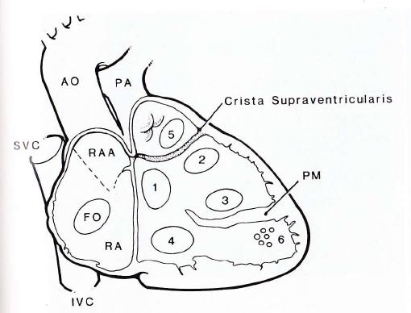
V e n t r icu la r Se p t a l D e f e ct
1.
Swiss cheese
Isola t e d V SD | N . Ca se s | %
Per im em br anous | 81 | 80
Muscular | 10 | 10
Mult iple | 10 | 10
Tot al | 101 | 100
Membranous
Outflow
Trabecular septum
Inflow
Subarterial / Supracristal
Anat om ical Collect ion of CHD, Univ er sit y of Padua:1400 hear t s

Slide 81
Location of septal and Moderator band
Kumar K et al. Circulation. 1997;95:1207-1213

Slide 82
Hemodynamic classification
Restrictive- resistance that limits the shunt at the site of VSD
LVSP > RVSP
Qp / Qs <1.4
Moderately restrictive - RVSP high, but less than LVSP
- Qp/Qs 1.4-2.2
Non restrictive -Shunt not limited at the site of defect
RVSP , LVSP, PA , Aortic systolic pressures equal
Qp/Qs >2.2
Flow determined by PVR
Eisenmenger VSD : Irreversible pulmonary HTN and shunt may be zero
or reversed (i.e. R→L)

Slide 83
SIZING THE VSD
Small | Moderate | Large
<1/3rd size of aortic valve annulus | >33% to < 50% | > 50%
shunt limited by size of the defect | offer some resistance | no resistance
 | > 20 mmHg gradient across defect | < 20 mmHg gradient across defect

